Slide 1
NEWSLETTER REVIEW
List health and engagement plan
A mailing list is like a garden!!
Our mailing list is alive. Leave it alone and it fills with weeds: dead addresses and people who never read. Look after it and it blooms. So, we treat it like a garden and nurture it.
Weed
Water
Grow
Clear out dead and silent contacts.
Send emails worth opening.
Welcome new, willing readers.
Marketing | October 2026
Notes:
Opening line: the newsletter is in better shape than many, but the list underneath it needs tidying. Think of the list as a garden. Weed it, water it and help it grow. Three parts: where we are, the clean-up, and the growth plan.

Slide 2

The newsletter is performing well
WHERE WE ARE
7.9%
0.96%
26 to 47%
Average click rate, July to September
Bounce rate, September
The share of emails that could not be delivered, such as dead addresses. Down from 5.6% in October 2025.
Up from 4.4% in January.
Open rate range across 12 sends
Which stacks up well against a Non-profit benchmark of around 35%
Opens are inflated by Apple Mail Privacy Protection, so we judge success on clicks.
Source: Mailchimp campaign reports, October 2025 to September 2026
Notes:
Open rates beat the sector benchmark every month, but Apple’s privacy feature counts machine opens, and about 40% of opens are geolocated to the US while the list is mostly UK. Clicks are the honest measure. Bounces have fallen from 5.6% to under 1%, so someone has already been weeding.

Slide 3
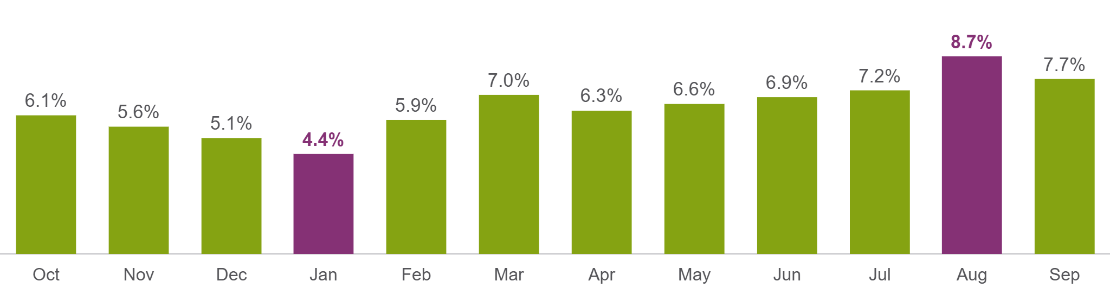
Click rate by send
WHERE WE ARE
Lowest in January (4.4%), highest in August (8.7%). Clicks per open rose from about 14% to about 26% over the same period.
Source: Mailchimp campaign reports, October 2025 to September 2026
Notes:
As the list got cleaner, the people who remain are doing more. Unsubscribe rates stay low, between 0% and 0.8% per send.

Slide 4
About 1 in 3 subscribers has ever clicked a link
THE LIST
419 of 1,311 subscribers, excluding Hutton staff. Each month’s clicks come from between 61 and 117 people, so the engaged core is small and loyal.
Source: Mailchimp audience and segment exports, 16 October 2026
Notes:
The weeding job is small. The real prize is the quiet middle: readers who open but never click.

Slide 5
The garden map
THE LIST
Group | Contacts | Share | What we do
Engaged core (the blooms) | 295 | 22% | Keep happy, use for subject line tests
Quiet readers (the seedlings) | 671 | 50% | Open but never click: nudge with better content
Lapsed clickers (the wilting ones) | 93 | 7% | Clicked before, quiet now: a “we’ve missed you” email
Never opened (the weeds) | 153 | 11% | The weeds: re-permission email, then archive the silent
New joiners (new seeds) | 99 | 7% | Joined since 15 October 2025: welcome them, judge later
Internal staff (the greenhouse) | 44 | 3% | Segment out of reporting
Every subscriber sits in exactly one group: 1,355 in total.
Source: Mailchimp audience and segment exports, 16 October 2026
Notes:
Engaged core means clicked in the last 6 months. Lapsed clickers have clicked at some point, but not in the last 6 months. Quiet readers have opened but never clicked. Never opened means no opens at all.

Slide 6
The clean-up in four steps
THE PLAN: WEEDING
1
2
3
4
Protect
Ask
Confirm
Archive
Leave new joiners (99) and staff (44) out of the clean-up.
Send the 153 never-opened contacts a “still want to hear from us?” email, with a follow-up a week later.
Count only a click on “Yes, keep me subscribed”. Opens do not count, because Apple inflates them.
After about three weeks, archive anyone who has not clicked. Archive rather than delete, so the history stays.
The list shrinks by 153 at most. Sender reputation and reporting both improve.
Notes:
A re-permission email doubles as a consent refresh for the 2021 import. The 93 lapsed clickers get a softer win-back message, not this one.

Slide 7
What the emails tell us
THE PLAN: WATERING
Fix now
Keep doing
A WordPress admin link took 24.9% of March clicks, and readers would hit a login page.
About a dozen Bing redirect links sit in the June and August issues. Swap them for clean URLs.
Every subject line reads “News from the Hutton [Month] Newsletter”.
Social icons get 0 to 1% of clicks, and stories carry two links each – one in picture, one in button.
Video links were among the top five links in six of the 12 issues.
Events and research stories pull well: the lecture links took about 20% of September clicks.
Commercial content works at the bottom: the Deep Time whisky link led August.
Long issues still get clicks near the end, so length is not the problem.
Source: Mailchimp campaign reports and click maps, October 2025 to September 2026
Notes:
Social icons, subject lines and link hygiene are quick wins. The WordPress admin link in March is the most urgent: it carried a quarter of that month’s clicks.

Slide 8
Six ideas to win more clicks
THE PLAN: GROWING
Better seed
A regular rhythm
A second chance
Lead subject lines with the story, and A/B test one every month.
Pick one send slot, then test mornings against late afternoons.
Resend to non-openers a few days later. The May resend won 134 opens and 23 clicks.
Different beds
Show, don’t tell
Spread the pollen
Interest segments: events, policy, farming and industry, research.
Make a 60-second video the lead story, since video links already do well.
Add a “forward to a colleague” nudge. Forwards are zero on every send.
Source: Mailchimp campaign reports and click maps, October 2025 to September 2026
Notes:
All six are low cost. The subject line test and the non-opener resend are the quickest to start.

Slide 9
The to-do list
NEXT STEPS
Tend the garden
Help it grow
Six Action segments have been created to help with nurturing going forward. Keep Action 6 (Internal staff) out of reporting.
Write the “still want to hear from us?” email for Action 4 (Never opened), with a “Yes, keep me subscribed” button and a reminder a week later.
After about three weeks, archive the Action 4 contacts who have not clicked.
Write a “we’ve missed you” email for Action 2 (Lapsed clickers).
Send a welcome email to Action 5 (New joiners).
Nudge Action 3 (Quiet readers) with click-led subject lines, tested first on Action 1 (Engaged core).
Fix the email issues: the WordPress admin link, the Bing links and try a ‘Follow us on LinkedIn for more’ rather than a row of social icons.
Agree one send slot and start monthly subject line tests.
Resend each issue to non-openers a few days later.
Agree targets for click rate, bounces and unsubscribes.
Brainstorm together: how do we bring in new, willing readers?
Action 1 to 6 are the segments set up in Mailchimp. The garden map slide explains each one.
Notes:
Owners and dates still to be agreed. The brainstorm is the last item: bring ideas for growing the list with genuine sign-ups.

